Slide 1
AI Ethics: A Review of Bias and Fairness in Machine Learning Models
Submitted in the partial fulfillment for the award of the degree of
BACHELOR OF ENGINEERING
IN
BIG DATA ANALYTICS
Submitted by:
Kamal Singh(22BDA70039)
Ayushika Singh Rajput(22BDA70020)
Piyush Mahawar(22BDA70126)
Under the Supervision of:
Dr. Sonam Sharma
Department of AIT-CSE
DISCOVER . LEARN . EMPOWER

Slide 2
Outline
Introduction to Project
Problem Formulation
Objectives
Methodology used
Results and Outputs
Conclusion
Future Scope
References

Slide 3
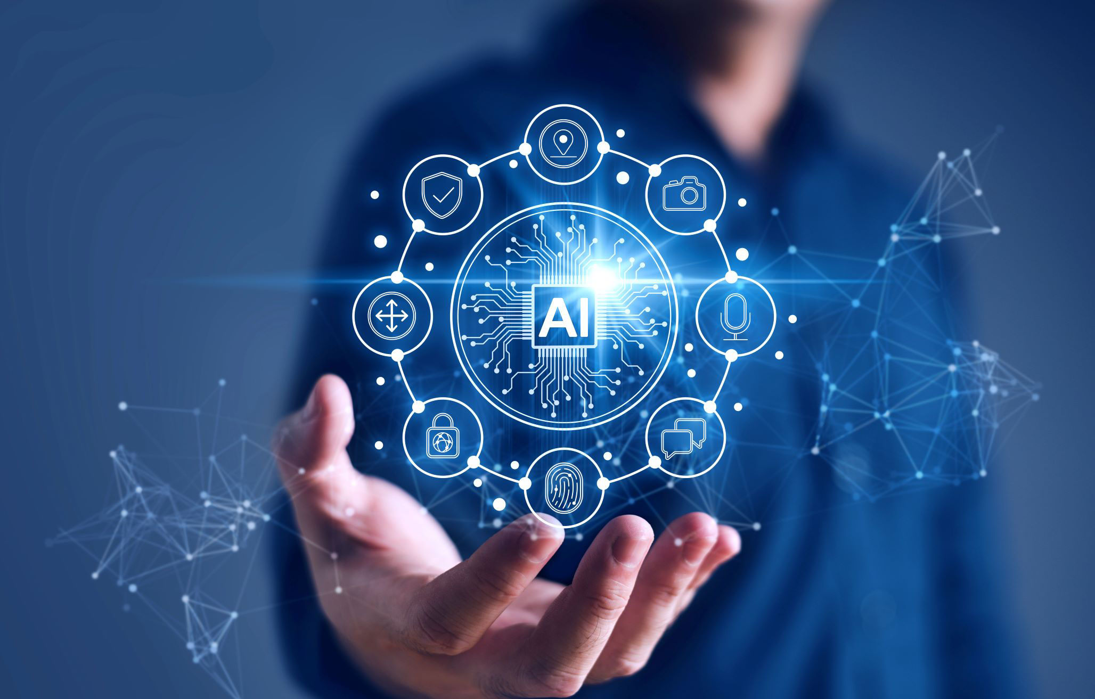
INTRODUCTION
AI systems depend on data → biased data → biased outputs.
Example: Hiring system preferring men due to biased historical data.
Fairness ensures equal treatment of all groups.
Bias comes from data, algorithms, and human judgement.
Requires fairness methods at all stages of the AI lifecycle.

Slide 4
INTRODUCTION TO PROJECT
AI and Machine Learning are used in many important areas like healthcare, banking, hiring, and law.
These systems learn from data, so if the data has mistakes or unfair patterns, the AI will also give biased results.
Bias in AI can cause unfair decisions that affect people, so it is important to make AI fair, transparent, and responsible.
This project studies how bias happens in AI, its effects, and the methods we can use to reduce it and make AI more fair.

Slide 5
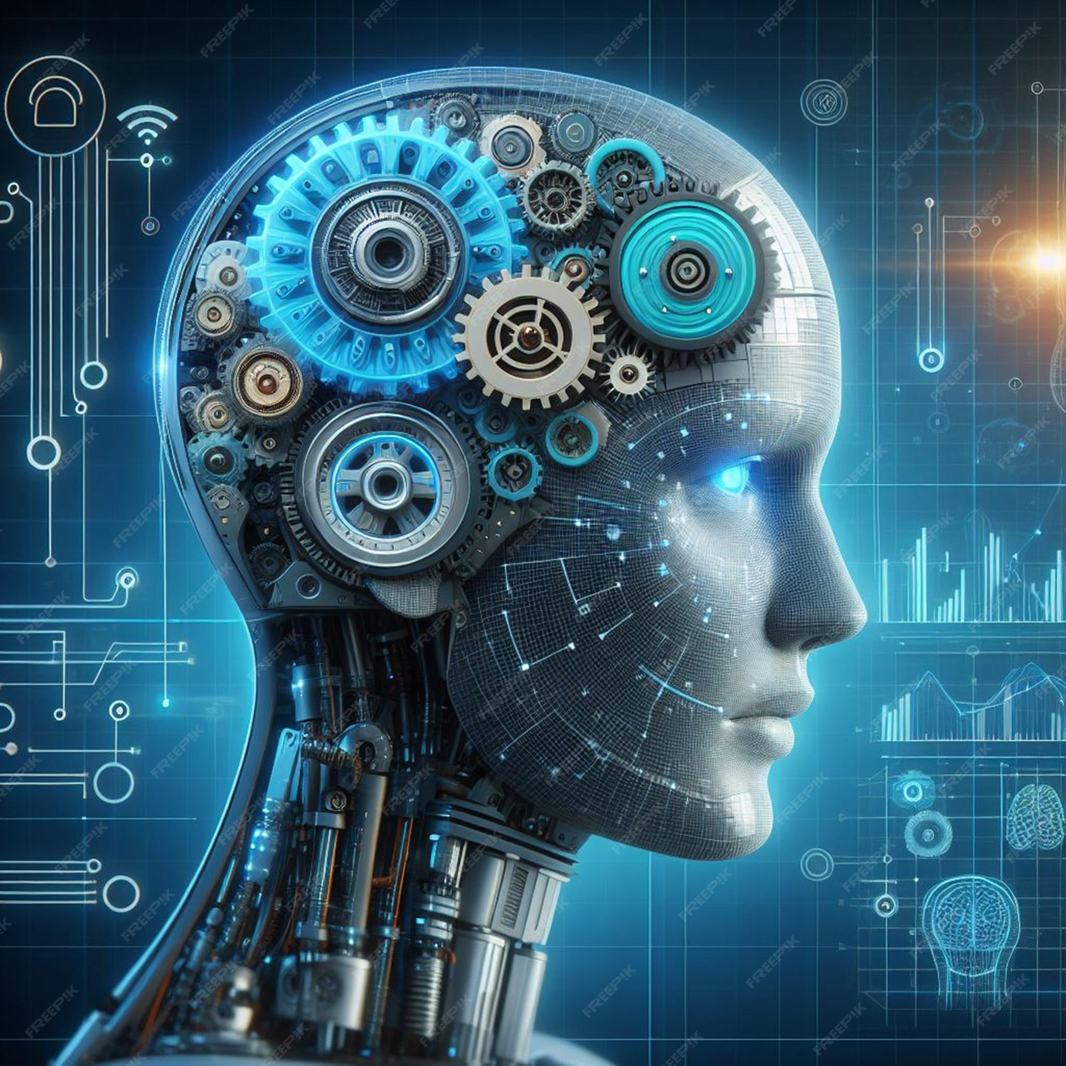
PROBLEM FORMULATION
AI systems learn from biased or incomplete data, causing unfair and unequal decisions.
There is no single standard method to detect or reduce bias in different AI models.
The main challenge is to find where bias enters the AI pipeline and apply methods to reduce it without reducing accuracy.

Slide 6
OBJECTIVES
To find out how bias enters AI and machine learning systems through data, algorithms, and human decisions.
To study different fairness techniques and tools (like AIF360 and Fairlearn) that help reduce bias in AI models.
To understand the ethical and social impact of biased AI in areas like healthcare, finance, hiring, and criminal justice.

Slide 7
METHODOLOGY
Data Collection & Exploration: Collect the dataset and check for imbalance, missing values, and under-represented groups.
Bias Identification: Use fairness metrics like demographic parity and equal opportunity to detect biased behavior.
Bias Mitigation: Apply techniques like SMOTE, resampling, fairness constraints, or debiasing algorithms (AIF360, Fairlearn).
Model Training & Evaluation: Train models with fairness-focused methods and evaluate using both accuracy and fairness metrics.
Continuous Monitoring: Track model performance and fairness over time to avoid bias drift after deployment.

Slide 8
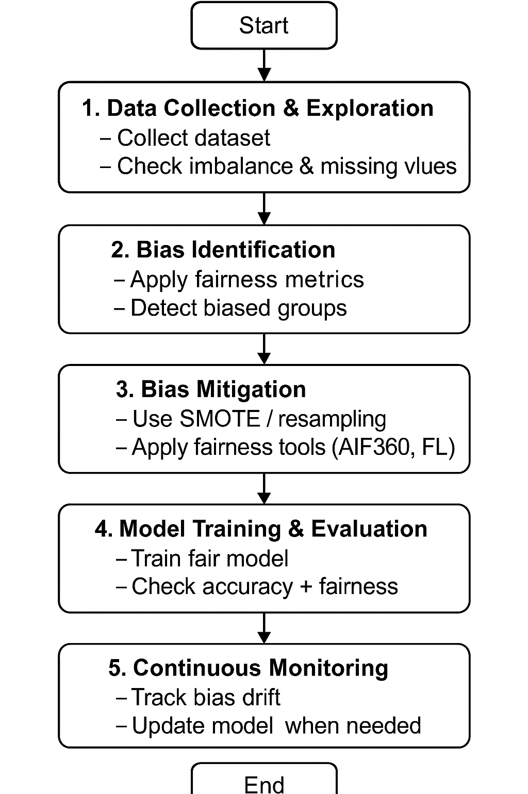
FLOWCHART

Slide 9
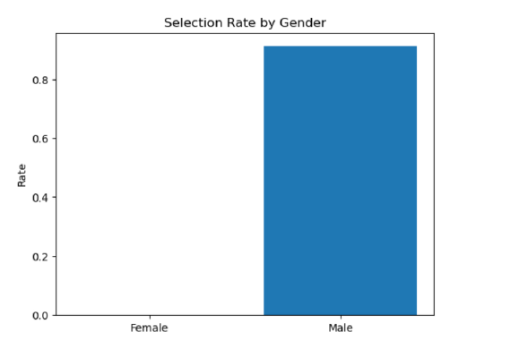
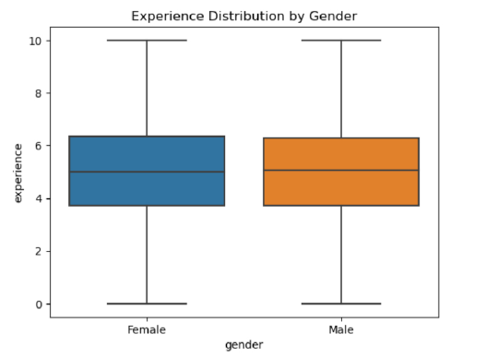
RESULTS AND OUTPUTS
“Selection Rate & Experience Distribution by Gender”

Slide 10
RESULTS AND OUTPUTS
The model showed bias in the beginning, and some groups were treated unfairly.
After applying bias-reduction methods, the fairness of the model improved.
The model gave more balanced and equal predictions for all groups.
Accuracy remained acceptable while fairness increased.

Slide 11
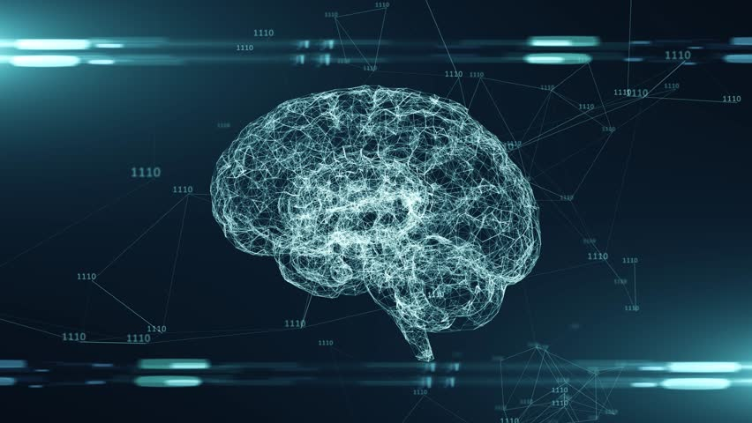
CONCLUSION
AI systems can become biased due to issues in data and algorithms, which can lead to unfair decisions. Ensuring fairness requires careful design, testing, and transparency.
Although bias-reduction tools help, achieving fully fair AI is still challenging. Continuous monitoring, ethical guidelines, and collaboration are needed to build trustworthy and responsible AI systems.

Slide 12
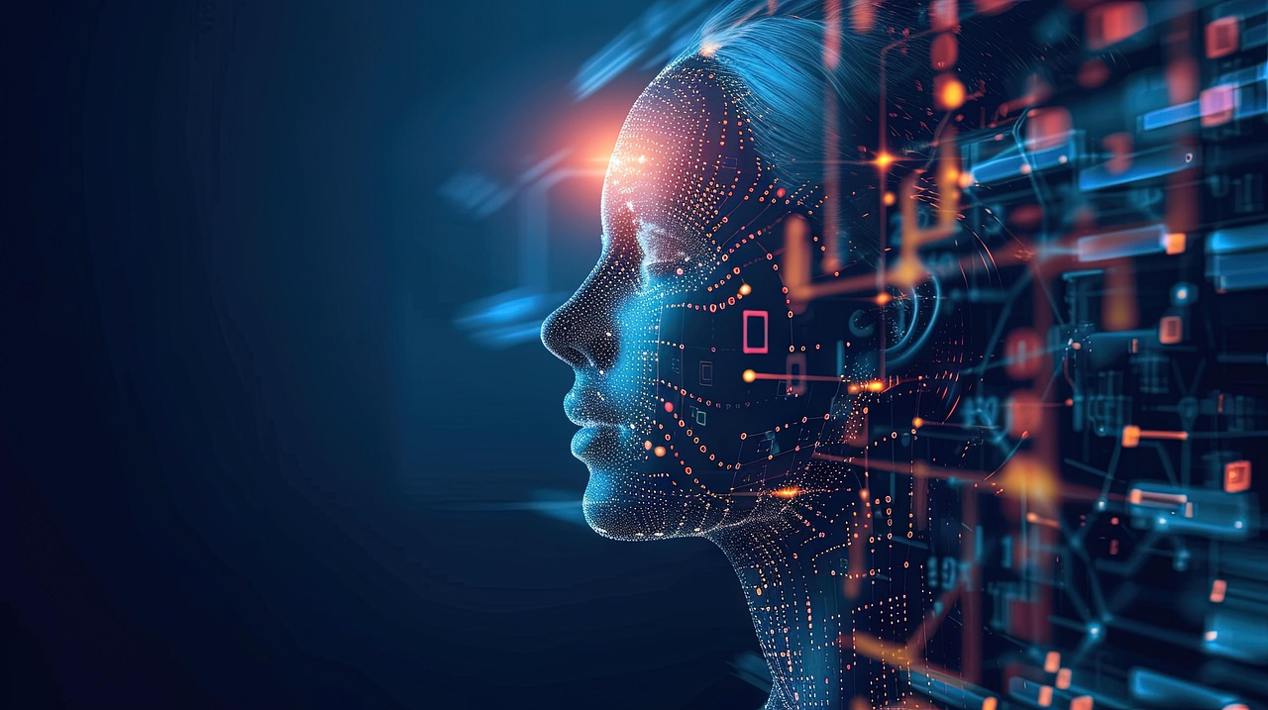
FUTURE SCOPE
Create clearer fairness rules for different fields.
Improve methods to detect hidden and intersectional bias.
Develop fairness tools for generative AI (text/images).
Stronger laws and regular audits for fair and safe AI.

Slide 13
REFERENCES
Nathim, K. W., Hameed, N. A., Salih, S. A., Taher, N. A., Salman, H. M., & Chornomordenko, D. (2024). Ethical AI with Balancing Bias Mitigation and Fairness in Machine Learning Models. PROCEEDING OF THE 36TH CONFERENCE OF FRUCT ASSOCIATION, 797–807.
Jaiswal, R. K., Sharma, S. S., & Kaushik, R. (2023). ETHICS IN AI AND MACHINE LEARNING. Journal of Nonlinear Analysis and Optimization, 14(1).
Kamatala, S., Naayini, P., & Myakala, P. K. (2025). Mitigating Bias in AI: A Framework for Ethical and Fair Machine Learning Models. International Journal of Research and Analytical Reviews (IJRAR), 12(1), 848–853.
Oyeniran, O. C., Adewusi, A. O., Adeleke, A. G., Akwawa, L. A., & Azubuko, C. F. (2022). Ethical AI: Addressing bias in machine learning models and software applications. Computer Science & IT Research Journal, 3(3), 115–126.

Slide 14
THANK YOU

